Slide 1


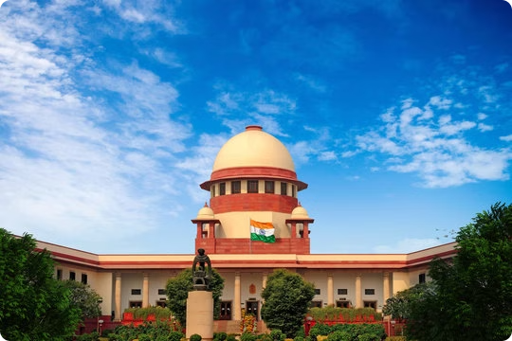
Statistical Analysis of the Pending Cases at the Lower Courts in India
by
Subhadeep Dey
and
Koustav Mazumder

Slide 2
Overview of the Indian Judicial System
Multi-Tiered Structure
Hierarchical Jurisdiction
The Indian judicial system follows a multi-tiered structure, with the Supreme Court at the apex, followed by High Courts at the state level, and a network of District and Taluk Courts at the local level.
The courts have a hierarchical jurisdiction, with the Supreme Court exercising appellate and advisory jurisdiction over the lower courts, ensuring a unified and consistent application of the law.
Specialized Tribunals
Role of Judiciary
The Indian judiciary plays a critical role in upholding the Constitution, protecting individual rights, and maintaining the rule of law, ensuring a balance of power between the executive, legislative, and judicial branches.
In addition to the traditional court system, India also has several specialized tribunals that handle specific types of cases, such as administrative, taxation, labor disputes etc.

Slide 3

Objectives of the Project
Judiciary is the backbone of any democratic machinery.
This analysis delves into the pressing issue of the growing backlog of pending cases in the district and taluk courts across India.
By examining the current state of affairs, we aim to uncover insights that can drive meaningful reforms and improve access to timely justice for all.

Slide 4

Data Collection
The dataset has been collected from the National Data and Analysis Platform (NDAP) which is a website having countless governmental data vis-a-vis the Government of India.
This web platform is maintained by the National Institution for Transforming India Aayog (NITI Aayog), an extra-constitutional body of the Government of India.

Slide 5
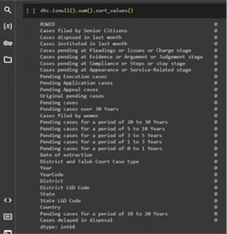
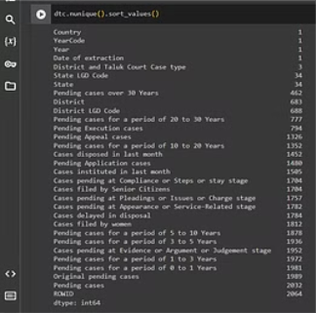

Data Preprocessing
We imported the data in python through pandas and checked whether there are null values, and if any what are their contributions in the entire dataset. Also we checked the number of unique values in each column.
After that we have deleted all the unnecessary columns from the dataset so that it becomes crisp and clear for doing the statistical analysis.

Slide 6


Methodology 1 (Hypothesis Testing: t-test)
Finding the disparity in resolving of cases between Civil and Criminal cases amongst the marginalized section of the society i.e. Women and Senior Citizens.
With that purpose we have conducted two t-tests.
A t-test for analyzing the means of the pending cases filed by senior citizens and filed by women in the district and taluk civil courts.
Another t-test for analyzing the means of the pending cases filed by senior citizens and filed by women in the district and taluk criminal courts.

Slide 7
The First t-test
H0: Cases filed by Women in civil courts take equal or more time than that of the Senior Citizens.
H1: Cases filed by Senior Citizen in civil courts take more time.
The Second t-test
H0: Cases filed by Senior Citizen in criminal courts take equal or more time than that of Women.
H1: Cases filed by Women in criminal courts take more time.

Slide 8
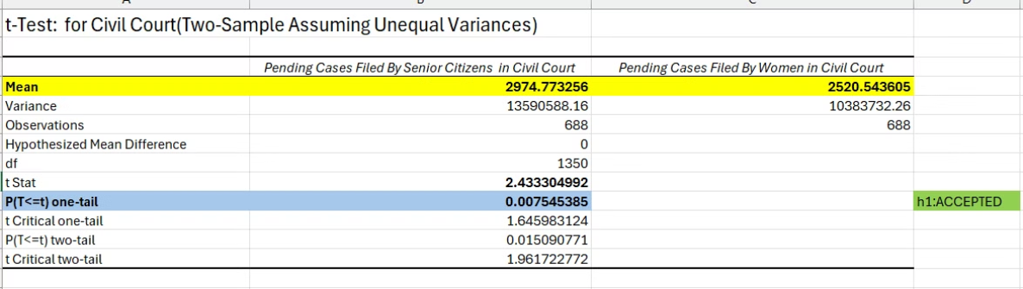
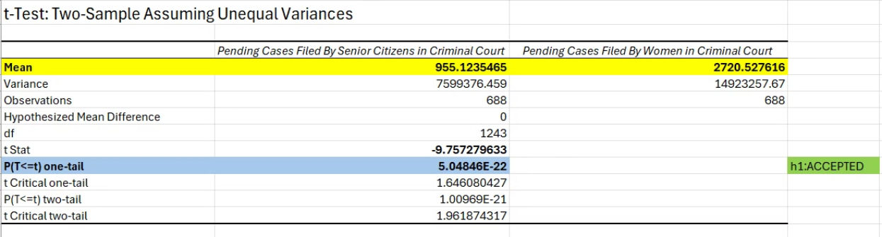
Results of the t-tests

Slide 9
Interpretation of the Result of First t-test
With the P-value of 0.0075 (which is <0.05), we can firmly say that our alternative hypothesis stands true. In other words, the cases filed by senior citizens in civil courts take more time than that of the women.
The mean value of the pending cases filed by senior citizen in civil courts (=2974.773) is greater than that of women (=2520.543).
Interpretation of the Result of Second t-test
With the P-value of 5.048 * E-22 (which is <<0.05), we can firmly say that our alternative hypothesis stands true. In other words, the cases filed by women in criminal courts take more time than that of the senior citizens.
The mean value of the pending cases filed by women in criminal courts (=2720.527) is greater than that of senior citizens (=955.123).

Slide 10

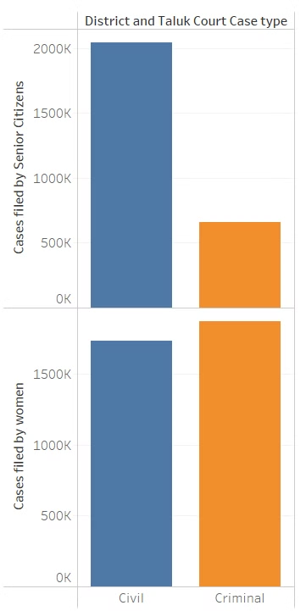
Interpretation of the Result of First t-test
With the P-value of 0.0075 (which is <0.05), we can firmly say that our alternative hypothesis stands true. In other words, the cases filed by senior citizens in civil courts take more time than that of the women.
The mean value of the pending cases filed by senior citizen in civil courts (=2974.773) is greater than that of women (=2520.543).
Interpretation of the Result of Second t-test
With the P-value of 5.048 * E-22 (which is <<0.05), we can firmly say that our alternative hypothesis stands true. In other words, the cases filed by women in criminal courts take more time than that of the senior citizens.
The mean value of the pending cases filed by women in criminal courts (=2720.527) is greater than that of senior citizens (=955.123).

Slide 11
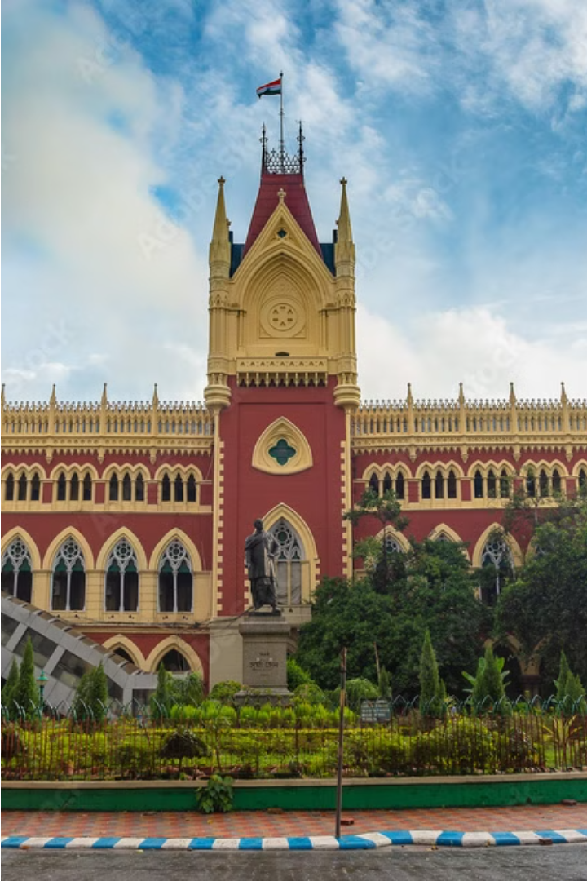
Methodology 1 (Hypothesis Testing: ANOVA)
In order to find the disparity in resolving of cases between Civil and Criminal cases across the country.
With that purpose we have conducted two ANOVA-tests.
The groups are formed based on duration of resolving with a gap of 10 years, i.e. 0 to 10 years, 10 to 20 years, 20 to 30 years, more than 30 years.
With the same groups we have conducted two ANOVA-tests, one for civil cases and another for the criminal cases.

Slide 12
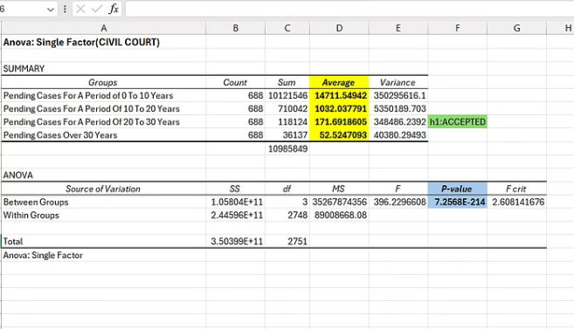
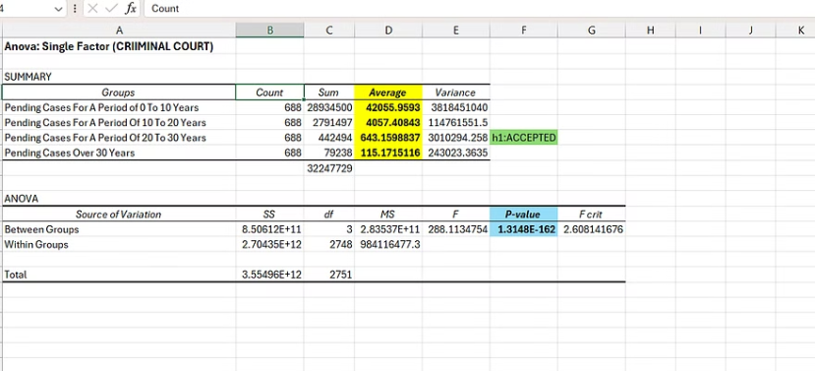
Results of the ANOVA-tests

Slide 13
Interpretation of the Result of First ANOVA-test
With the P-value of 7.3 * E-214 (which is <<0.05), we can firmly say that our alternative hypothesis stands true. In other words, the at least one of the averages will not be equal.
The average pending cases within 0-10 years for civil cases per district (or taluk) is 14,711.55
The average pending cases within 10-20 years for civil cases per district (or taluk) is 1,032.038
Total civil cases pending at district and taluk courts is 1,09,85,849.
Interpretation of the Result of Second ANOVA-test
With the P-value of 1.3 * E-162 (which is <<0.05), we can firmly say that our alternative hypothesis stands true. In other words, the at least one of the averages will not be equal.
The average pending cases within 0-10 years for criminal cases per district (or taluk) is 42,055.96
The average pending cases within 10-20 years for criminal cases per district (or taluk) is 4,057.41
Total criminal cases pending at district and taluk courts is 3,22,47,729.
The total number of cases pending only at district and taluk courts is 4,32,33,578.

Slide 14

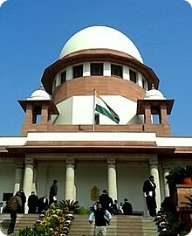
Methodology 2 (Multivariate Regression)
In order to examine the factors behind the increasing backlog of the pending cases in the Indian judiciary system, we have conducted a multivariate regression taking the total number of pending cases as the dependent variable (or Y).

Slide 15
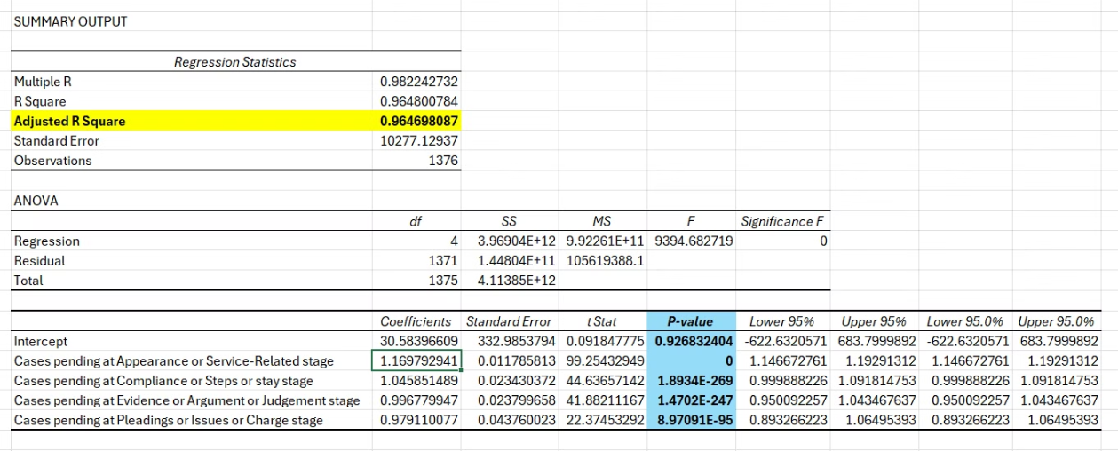
Result & Interpretation of the First Regression
With an adjusted R2 value of 0.964 that indicates that approximately 96.4% of the variance in dependent variable (Total pending cases) can be explained by the 4 independent variables present in this model.
The P-values of all 4 independent variables are significant (<0.05) and thereby implying that all 4 of them have a significant effect on the total pending cases.

Slide 16
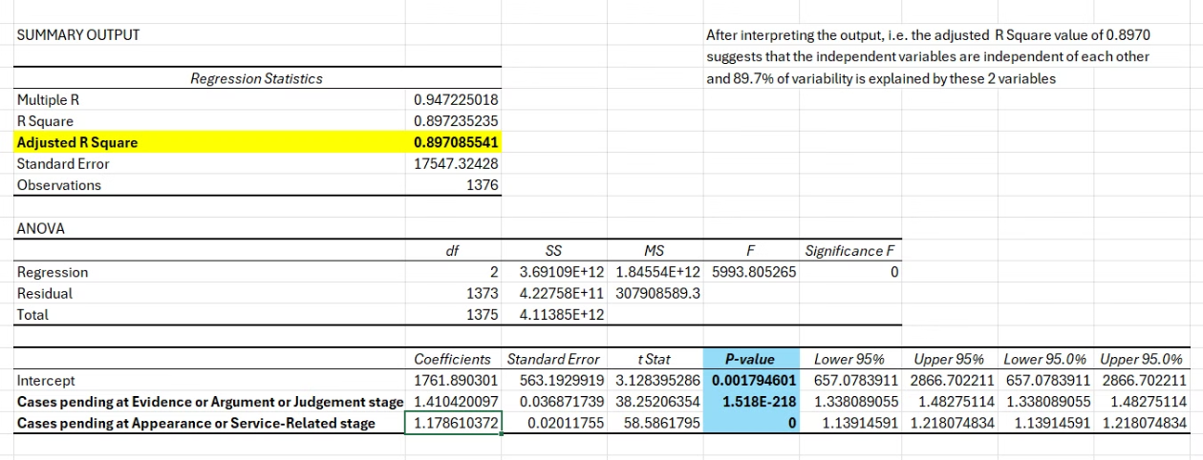
Result & Interpretation of the Second Regression
With an adjusted R2 value of 0.897, that indicates that approximately 90% of the variance in dependent variable (Total pending cases) can be explained by the 2 independent variables present in this model.
The P-values of all 2 independent variables are significant (<0.05) and thereby implying that all 2 of them have a significant effect on the total pending cases.

Slide 17
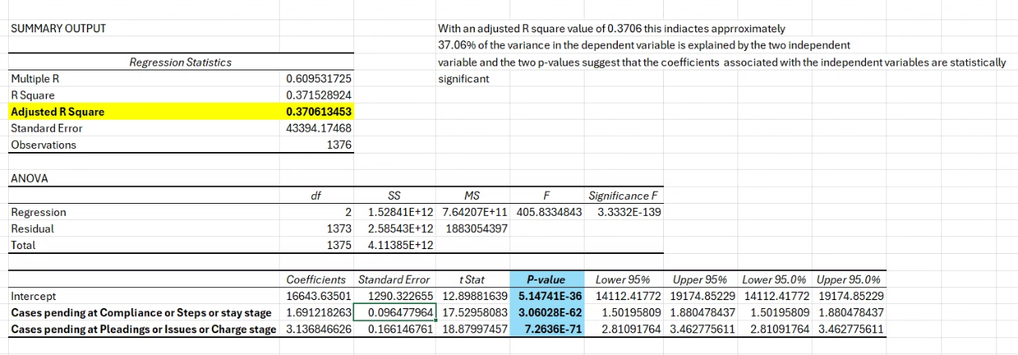
Result & Interpretation of the Third Regression
With an adjusted R2 value of 0.37,that indicates that approximately only 37% of the variance in dependent variable (Total pending cases) can be explained by the 2 independent variables present in this model, which is not considered good enough. It also signifies that there can be other factors also which will affect the dependent variable.
The P-values of all 2 independent variables are significant (<0.05) and thereby implying that all 2 of them have a significant effect on the total pending cases.

Slide 18
Reasons behind the Pending Cases at the District & Taluk Court Level
Understaffed & Over-burdened Police Force
1
As per the Supreme Court of India, the police force is heavily over-burdened while performing the dual duty of maintaining the law-and-order along with the investigations of the cases.
2
Lack of Court Rooms
Adequacy of the judicial infrastructure is a prerequisite for the reduction of pendency and backlog of cases at the lower courts of India, unfortunately which is not the case in India considering the present scenario.
Delays and Backlogs
3
Lengthy delays in case adjudication and a growing backlog of pending cases have become the norm in many district courts, negatively affecting in an exponential manner the timely delivery of justice.

Slide 19


Some Interesting Insights from the Data

Slide 20
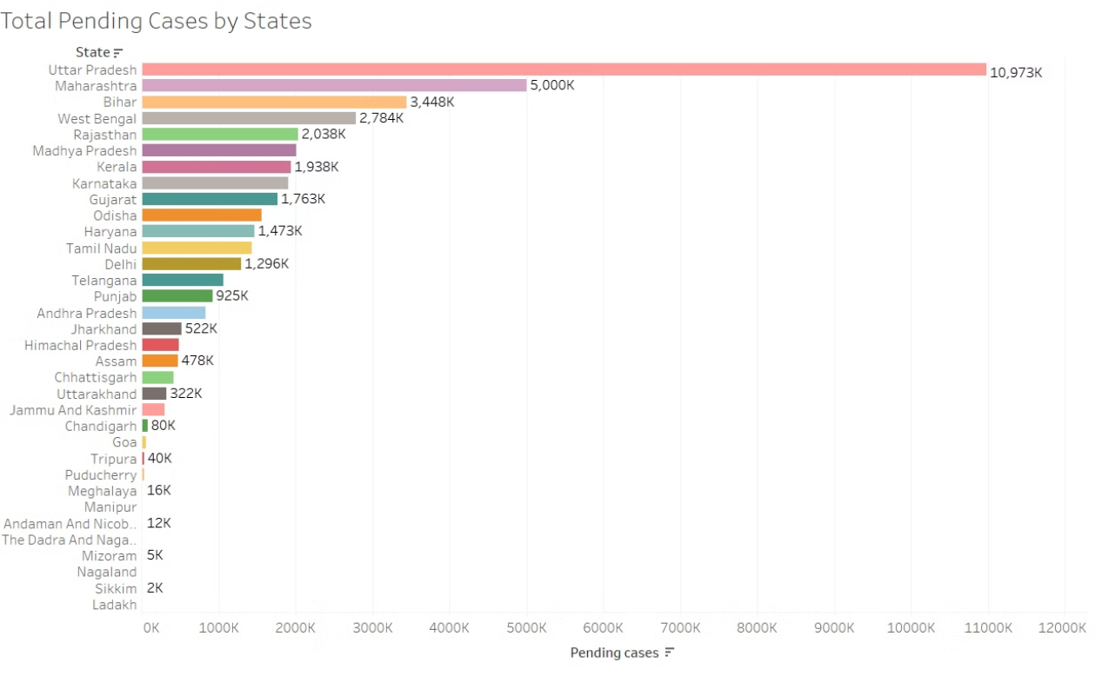
Total Pending Cases by States

Slide 21
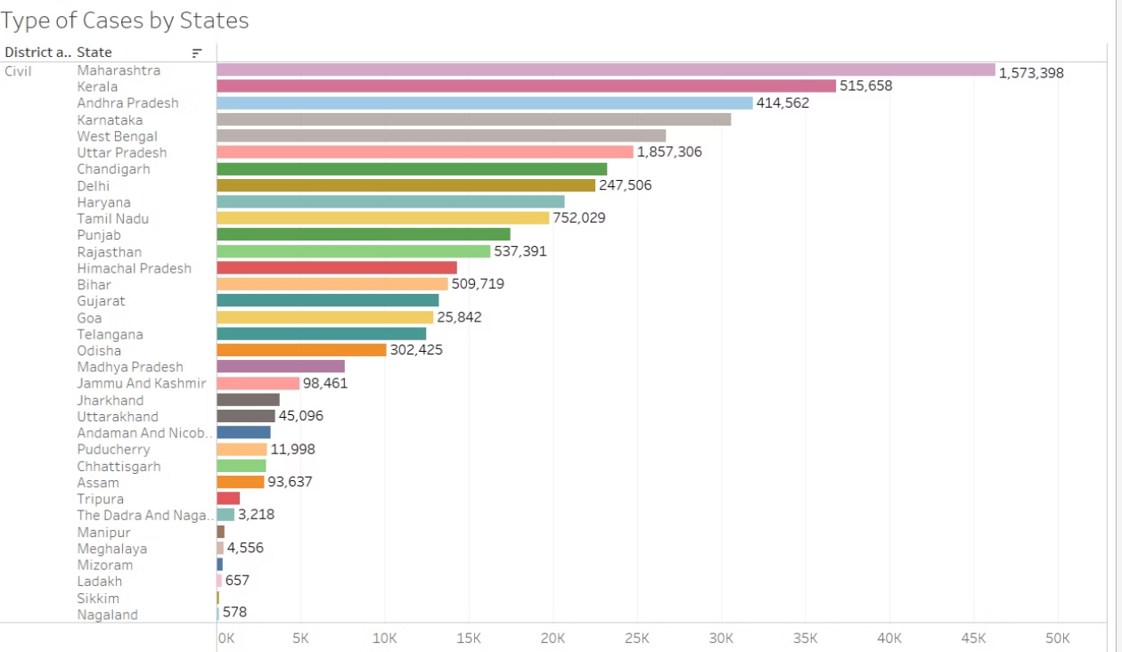
Total Pending Civil Cases by States

Slide 22
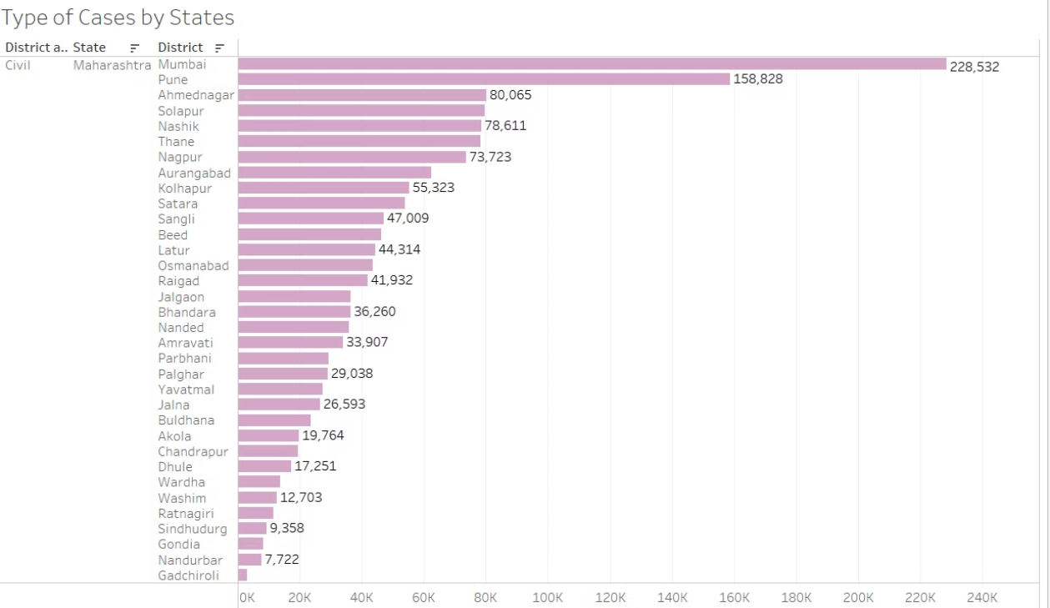
Total Pending Civil Cases by Districts in Maharashtra

Slide 23
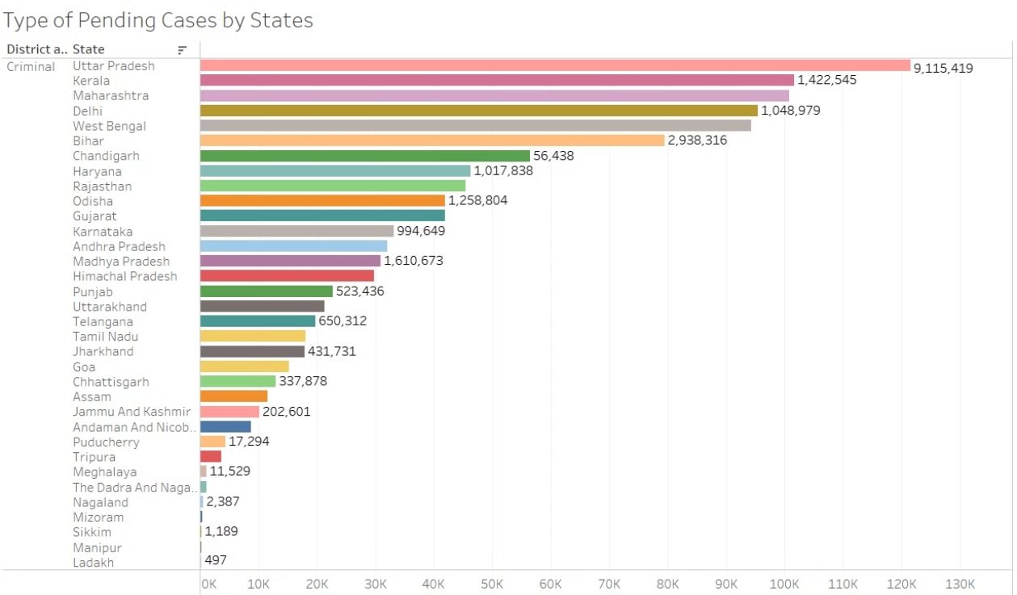
Total Pending Criminal Cases by States

Slide 24
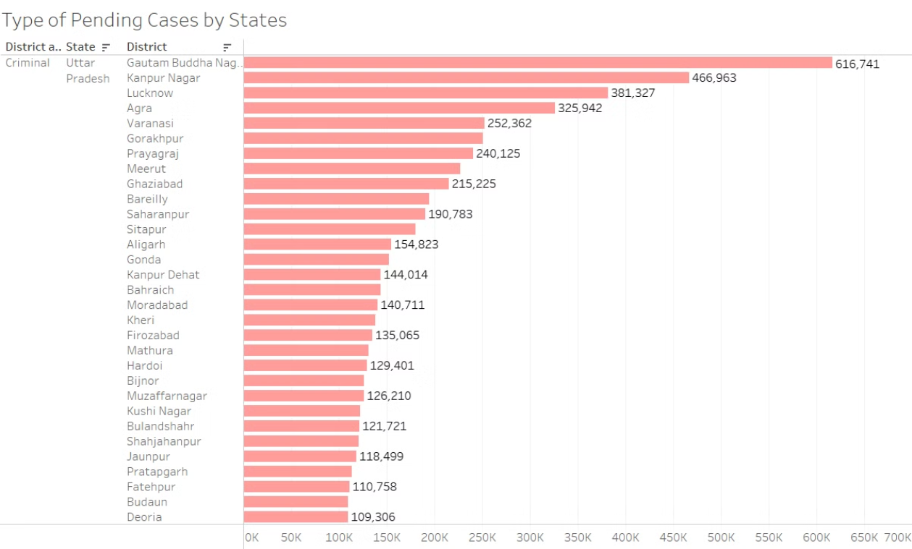
Total Pending Criminal Cases by Districts in Uttar Pradesh

Slide 25
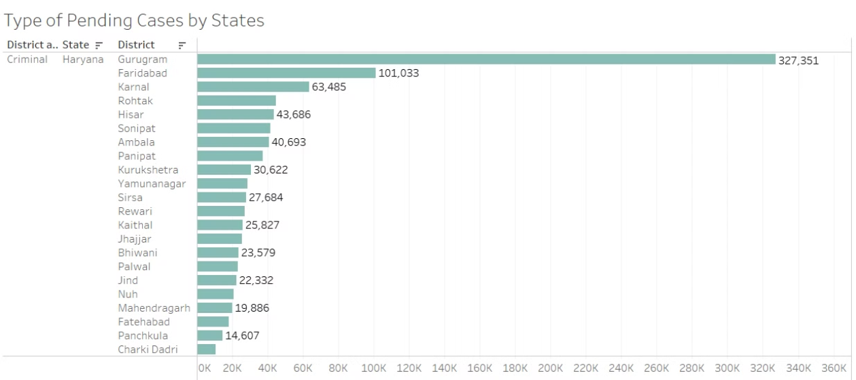
Total Pending Criminal Cases by Districts in Haryana

Slide 26
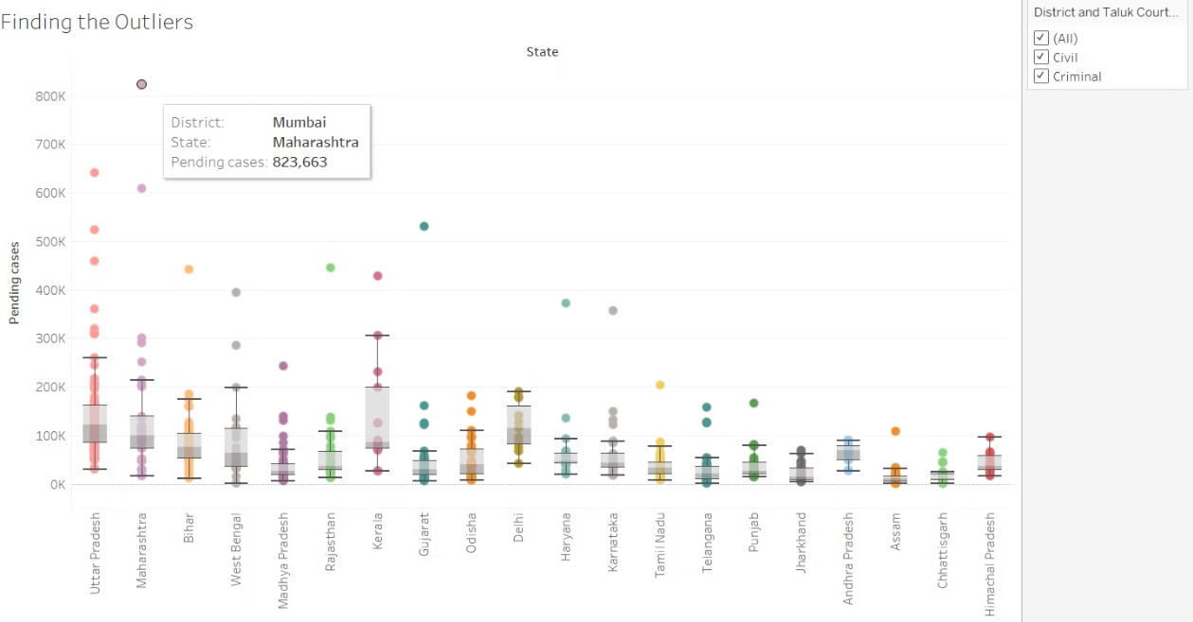
The Total Outliers

Slide 27
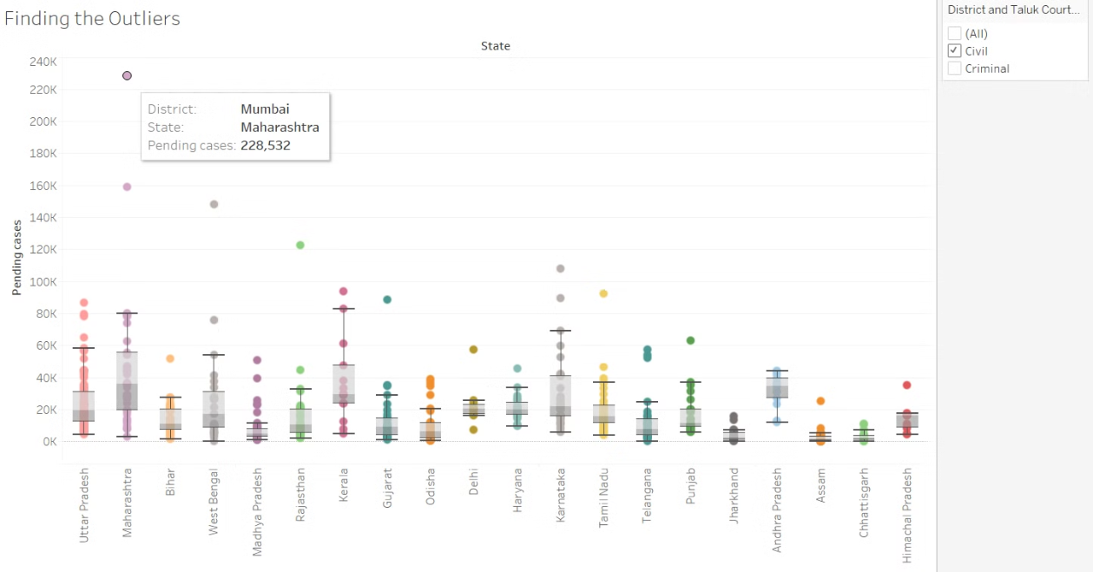
The Civil Outliers

Slide 28
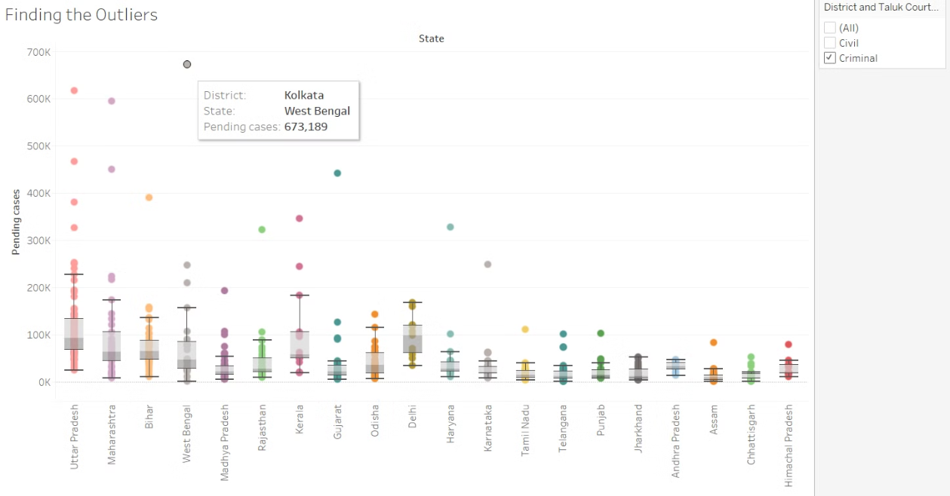
The Criminal Outliers

Slide 29
Impact of Pending Cases on the Delivery of Justice
1
Delays in Trials and Sentencing
2
Overcrowding in Prisons
The growing backlog of pending cases leads to lengthy delays in court proceedings, with trials and sentencing being significantly delayed, denying timely justice to litigants.
The slow pace of the judicial process results in an increased number of undertrials in prisons, leading to overcrowding and poor living conditions for inmates.
3
Erosion of Public Confidence
4
Impediments to Economic Growth
The lack of timely justice and the growing backlog of cases erodes public confidence in the judicial system, undermining its credibility and legitimacy.
The inefficiency of the courts and the delays in dispute resolution can have adverse impacts on economic development and investment, hampering overall economic growth.

Slide 30




Recommendations for Improving Court Efficiency
Judicial Reforms
Stakeholder Engagement
Time-Bound Goals
Capacity Building
Implement comprehensive judicial reforms, including increasing judgeships, streamlining case management, and leveraging technology to enhance efficiency.
Invest in training and professional development for judges and court staff to improve case management and dispute resolution skills.
Foster collaboration between the judiciary, government, and legal community to develop and execute a holistic strategy to address the backlog.
Establish clear, time-bound targets for reducing pending cases and regularly monitor progress to ensure accountability.

Slide 31



Conclusion
Increase Judicial Capacity
Enhance the judicial infrastructure by increasing the number of courtrooms at the lower level of judiciary
1
Procedural Reforms
Police reforms : separate the functions of law-and-order and investigation within the police forces (as per the recommendations of the Ribeiro Committee, 1998)
2
Technology Integration
3
Digitize court processes and leverage AI for case administration
To address the backlog of pending cases, more women centric courts are needed at the lower level of judiciary for speedy trial of the cases filed by them.

Slide 32
Thank You

